Slide 1
Business Process Simulation Webinar: Exploring the Temporal & Control Perspectives – Using Example 2 (Originating a Home Loan) from the BPSim Implementation Guide –
(TBD)
Presenter: Lloyd Dugan

Slide 2
Outline
Learning Objectives
Process Analysis Using Simulation (Temporal & Control Perspectives)
Simulating Business Processes Modeled in BPMN
(Overview of Simulation and BPSim)
Sample Process Walkthrough of Temporal & Control Perspectives
(Process Simulation, Diagnosis, and Redesign Example)
Simulation Parameters in BPMN Models
(Loan Process Model Example)
Simulation of Loan Process Model
(Demonstration of Temporal & Control Perspectives in the As-Is Analysis)
Simulation Diagnostics & Process Redesign
(Demonstration of Temporal & Control Perspectives in the To-Be Redesign)
Summary
Questions & Answers
Simulation Tools Showcased in this Webinar
Presenter Bio

Slide 3
Learning Objectives
At the end of this webinar, you will know…
Purposes of process analysis through simulation, relating the reasons for simulating processes to specific aspects of the model
Key concepts of simulation with BPMN models, focusing on the temporal perspective, work queues, and processing times
Note: Assumes basic understanding of core BPMN concepts
Process model element simulation parameters (structural parameters) and process performer simulation parameters (non-structural parameters), connecting them to the behaviors of the model
Simulation of a process model can be used to diagnose performance problems, and lead to remediation of performance problems
Recognizing patterns of performance problems and typical solutions to those patterns as surfaced through process simulation

Slide 4
Simulating Business Processes Modeled in BPMN (Overview of Simulation and BPSim)

Slide 5
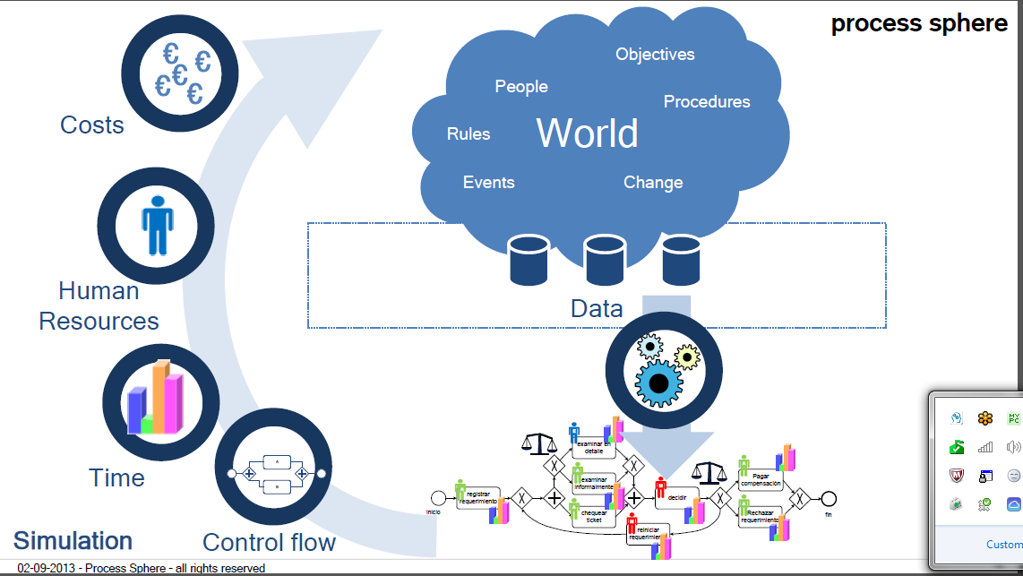
Process Analysis Using Simulation
Analyze the business process through simulation of its corresponding model to answer specific questions!
Analyze the business process through simulation of its corresponding model to answer specific questions!
Analyze the business process through simulation of its corresponding model to answer specific questions!

Slide 6
Simulation of a Business Process
Business process model represents an abstract approximation of an actual business process
For example, one done in BPMN
But: “All Models Are Wrong, Though Some Are Useful” – George Box (famous mathematician and statistician)
Business process is characterized by measurable performance characteristics, such as those in the temporal perspective
Time it takes to execute individual constituent activities (cycle time)
Time it takes to execute through all constituent activities (time-in-system)
Leftover work from inability to finish within allotted work time work-in-progress (WIP)
Simulation provides the means by which to measure performance characteristics of the process using the model instead of the real thing!

Slide 7


Process Simulation Perspectives
Parameterization of a Business Process Model from different perspectives for process analysis, simulation, and optimization purposes
Time
Today’s Focuses
Control
The Business Process Simulation (BPSim) Specification:
Supports both inputs (parametric data) into a simulation and outputs (result set) of a simulation
Maps to modeling notation concepts and semantics, including schemas, for BPMN 2.0 (from OMG) and XPDL (from WfMC)
Is consistent with core simulation concepts and principles
Provides consistent simulation model interchange among tools
Process
Resource
Cost
- Graphic pprepared by Denis Gagne, Founder of Trisotech and the Business Process Incubator
Property
Priority

Slide 8
Purposes of Simulation
(1) Confirmation of the Operational Behaviors of the Model:
(1A) Compliance With the Semantics of the Modeling Language
Does the simulation generate correct operational behaviors with respect to the language used to model the business process?
(1B) Fidelity With Respect To the Modeled Business Process
Does the simulation yield performance results similar to what is actually experienced for the business process?
(2) Analysis of the Operational Behaviors of the Model:
(2A) Identify Performance Problems of the Process
Do the simulation results lead to the identification of the underlying sources of performance problems of the as-is process?
(2B) Facilitate Reengineering of the Process
Does the simulation support what-if and sensitivity analyses through the design and re-parameterization of the to-be process?
Color-Coding of Bullets Maps To Simulation Results Shown Later

Slide 9
Process Models and Simulations
Structural Aspects of a Model that Relate To Simulation
Process model structure channels the flow of a process instance through one or more activities/events by way of one or more routes via control flow and assignment flow
Combination of performance characteristics for channel routes and executed activities/events define and constrain the overall operational performance of the process
Non-structural Aspects of a Model that Relate To Simulation
Performers (as resources) are consumed when an activity occurs, which can be constrained based on parameters
Execution of activities/events, and therefore collectively for a process, have costs that can be calculated

Slide 10
Sample Process Walkthrough of Temporal & Control Perspectives (Process Simulation, Diagnosis, and Redesign Example)

Slide 11
Process Walkthrough – Baseline Configuration
Baseline Configuration
+
No Work Item Duration Variation
Work Item Timing |  | Activity #1 (3 mins./item) |  | Activity #2 (2 mins./item)
Time (:min.) | Arrival Work Item # | Resource A Work Item # | Resource B Work Item # | Resource C Work Item #
:00 | - | - | - | -
:01 | 1 | 1 | - | -
:02 | - | 1 | - | -
:03 | 2 | 1 | 2 | -
:04 | - | - | 2 | 1
:05 | 3 | 3 | 2 | 1
:06 | - | 3 | - | 2
:07 | 4 | 3 | 4 | 2
Assumptions:
Work day starts out with empty queues
Work item arrives every other min.
Each work item requires the same Activity #1 time
Each work item requires the same Activity #2 time
Resources are unconstrained (i.e., available as needed)
Observations:
Work item avgs. 5 mins. total (sum of durations)
2 work items were completed in first 7 mins.
Only 1 work item is WIP in first 7 mins.

Slide 12
Process Walkthrough – Work Item Variation
Baseline Configuration
+
Work Item Duration Variation
Work Item Timing |  | Activity #1 (3 mins. simple or 5 mins. complex/item) |  | Activity #2 (2 mins./item)
Time (:min.) | Arrival Work Item # | Resource A Work Item # | Resource B Work Item # | Resource C Work Item #
:00 | - | - | - | -
:01 | 1 | 1 | - | -
:02 | - | 1 | - | -
:03 | 2 | 1 | 2 | -
:04 | - | - | 2 | 1
:05 | 3 | 3 | 2 | 1
:06 | - | 3 | 2 | -
:07 | 4 | 3 | 2 | -
Assumptions:
Work day starts out with empty queues
Work item arrives every other min.
Each work item varies in the Activity #1 time
Each work item requires the same Activity #2 time
Resources are unconstrained (i.e., available as needed)
Observations:
Work item avgs. >5 minutes total (sum of durations)
Only 1 work item was completed in first 7 mins.
2 work items are WIP in first 7 mins.

Slide 13
Process Walkthrough – Triage Configuration
Triage Configuration
+
No Work Item Duration Variation
Timing |  | Task 1A - Complex (3 mins./item) | Task 1B - Simple (3 mins./item) | Task 2 (2 mins./item)
Time (:min.) | Arrival Work Item # | Resource A Work Item # | Resource B Work Item # | Resource C Work Item #
:00 | - | - | - | -
:01 | 1 | - | 1 | -
:02 | - | - | 1 | -
:03 | 2 | 2 | 1 | -
:04 | - | 2 |  | 1
:05 | 3 | 2 | 3 | 1
:06 | - | - | 3 | 2
:07 | 4 | 4 | 3 | 2
Assumptions:
Work day starts out with empty queues
Work item arrives every other min.
Each work item requires the same Activity #1A/#1B time
Each work item requires the same Activity #2 time
Resources are unconstrained (i.e., available as needed)
Observations:
Work item avgs. 5 mins. total (sum of durations)
2 work items were completed in first 7 mins.
Only 1 work item is WIP in first 7 mins.

Slide 14
Simulation Parameters in BPMN Models (Loan Process Model Example)

Slide 15
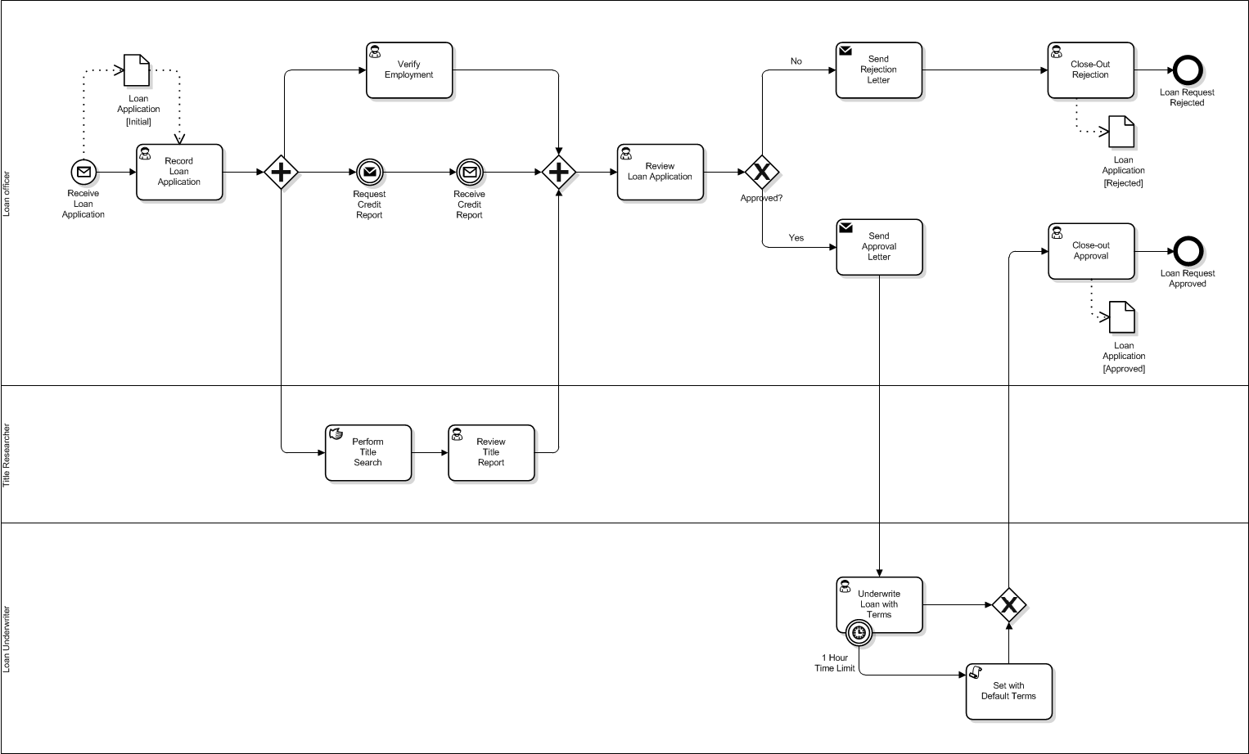
Simulation Parameters Match Behaviors of BPMN Elements
Loan Process Model Example
End Events and Intermediate Throwing Events have no parameters
Probability is assigned to exclusive branching paths that must sum to 1
Start Event and Intermediate Catching Event have an Inter-trigger Timer that is the occurrence rate (e.g., rate of arrivals)
Activities have processing times only with no constraints on resources or implicit lag times in execution of instances
NOTE: Values used as simulation parameters can come from historical data, time-and-motion studies, and best guesses
Boundary Event interrupts execution of attached-to activity if defined condition is met (e.g., duration takes more than 1 hour)

Slide 16
Simulation Parameters and Statistics
Simulation parameters can incorporate uncertainty ... or not
Probabilistic values are defined by a mean (or average) and distribution that has a standard deviation from it
Static values are fixed for the duration of the simulation
Simulation parameters as probabilistic values
Expected value = mean value that is expected to occur for a random instance from a population of instances
Distribution = defines the probability of a particular value for an instance occurring within a population of instances
Standard Deviation = a measure of the variation of possible values for an instance away from the mean
Simulation parameters must be correctly matched with the appropriate elements within the model

Slide 17
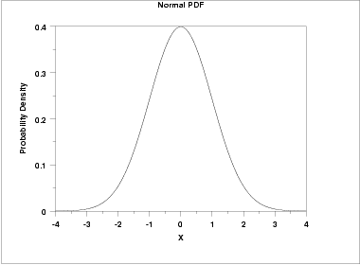
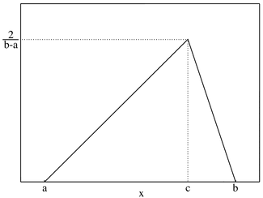
Common Distributions for Activities and Events
Probability Distribution
Normal (Gaussian) Distribution: Distribution used to reflect the “normal” variation within a population of things being counted or measured, which is typically the default distribution to be used due to its suitability for use with most organic and mechanical activities
Mean (Average)
Standard Deviations
Probability Distribution
Triangular Distribution: Distribution used to reflect the variation between minimum and maximum values with a peak (mode) value somewhere in between, all of which are easier to determine with a population size that is too small for use with the Normal Distribution
Min
Mode
Max

Slide 18
Simulation of Loan Process Model (Demonstration of Temporal & Control Perspectives in the As-Is Analysis)

Slide 19
Simulation Use Case
Originate Home Loan Process
Pre-condition: Beginning of a standard work week (5 business days at 8 hours per day) with no WIP in the pipeline of the Originate Loan Process for the XYZ Bank
Process Description (to be modeled in BPMN):
A Loan Officer receives a completed loan application (from a borrower), and records the application information.
A Loan Officer then verifies provided employment information, recording the result of his/her investigation.
The borrower’s credit score and report are requested of and received from the three credit bureaus in a consolidated form.
A Title Researcher searches the county title records for the property in question, and then determines whether or not the property is correctly listed and free of liens.
A Loan Officer assembles and reviews the case file (loan application with employment verification, credit score and report, and title results) to approve or reject the application.
If rejected, a Loan Officer sends a rejection notice to the borrower, and then closes out the rejected case file.
If approved, a Loan Officer sends an approval notice to the borrower, and then forwards the case file to an Underwriter.
An Underwriter underwrites the loan based on the case file, returning it to the Loan Officer, but if this takes more than an hour, then standard loan terms are assigned.
The Loan Officer then closes out the approved case file.
Post-condition: End of a standard work week with minimal WIP still in the pipeline

Slide 20
Simulation Use Case – Goals and Performance Measures
Process Performance Goals and Measures (as established by XYZ Bank Management):
No problematic backlog at the end of a standard 5 business days week (acceptable WIP only)
QoS Targets:
Minimum: Weighted average turn-around time for a loan (across all accepted and rejected loans) should be no more than 2.5 hours (150 minutes)
Stretch: No loan should take more than 3 hours (180 minutes) to process
Reengineering Imperative Established By XYZ Bank Management For the To-Be Redesign:
Analyze process to identify any leverage points for achieving process performance goals and measures
Targeted change(s) to process to ensure process performance goals and measures are achieved

Slide 21
Simulation Use Case – Parameters
Parametric Data For Simulation (as determined by TPS Reports, Inc.):
30 applications arrive per day (on avg.) <for the Receive Loan Application Start Event (the process trigger)>
8 out of the 30 are approved (on avg.) and about a fifth of the rejections have very low credit scores <for control flow>
Credit score receipt is within 4 to 6 minutes of request, but is usually 5 mins <for the Intermediate Catching Event>
Average duration times for activities are listed below: <for parameterizing activities>
Activity Name | Approval Path | Rejection Path
Record Loan Application | 20
Verify Employment | 30
Perform Title Search | 60
Review Title Report | 20
Review Loan Application | 30
Send Rejection Letter |  | 1 (system constant)
Close-Out Rejection |  | 5
Send Approval Letter | 1 (system constant)
Underwrite Loan With Terms | 50 (max of 60)
Set With Default Terms (if applicable) | 1 (system constant)
Close-Out Approval | 10
TOTAL (Averages and Constants) | 191 or 202 | 136
Totals 80
for the parallel thread
Max is 80 for all parallel threads
Measured weighted average of time-in-system for approved and rejected loans is about 150 minutes with a maximum of well over 180 minutes
Measured incidence of WIP is that it occurs in modest weekly increments

Slide 22
Simulation Use Case – Initial Model
What are the Counts for each pair of outcomes, and is there backlog or merely WIP in the pipeline?
What is the average and maximum Time-in-System (weighted sum of cycle times) for a Loan Application?
Run the simulation to answer these questions

Slide 23
Simulation Use Case – 1st Result (Failed)
5 minutes (on average)
Simulation Purpose (1A): Compliance With the Semantics of the Modeling Language!!!
Unable to answer these questions because this catching event was not parameterized as needed for its BPMN behavior, preventing process instances from advancing, so fix and rerun simulation
What are the Counts for each pair of outcomes, and is there backlog or merely WIP in the pipeline?
What is the average and maximum Time-in-System (weighted sum of cycle times) for a Loan Application?

Slide 24
Simulation Use Case – 2nd Result (Successful)
93
Closed
132
Received
32
Closed
Simulation Purpose (1B): Fidelity With Respect To the Modeled Business Process!!!
What are the Counts for each pair of outcomes, and is there backlog or merely WIP in the pipeline?
What is the average and maximum Time-in-System (weighted sum of cycle times) for a Loan Application?
WIP: | Time-in-System Avg. | Time-in-System Max.
132 - (93+32) = 7 | 149.7 mins. | 223.6 mins.
Consistent With Measured Historical Data

Slide 25
Simulation Diagnostics & Process Redesign (Demonstration of Temporal & Control Perspectives in the To-Be Redesign)

Slide 26
What Can Simulation Show?
Performance Problems Surfaced Through the Temporal Perspective
Long time-in-system => is this an internal QoS violation or an external service level agreement (SLA) failure?
Large backlog/WIP => is there a cause of backlog as new work not getting done (e.g., a bottleneck) or is it just acceptable WIP in the pipeline?
Structural Changes Informed Through the Temporal Perspective
Revise the process structure (i.e., the sequence of activities) to streamline the flow of work <see applicable reengineering patterns>
Change the type of execution mode for activities (e.g., the task type) to reduce cycle times <see applicable reengineering patterns>

Slide 27
Simulation Use Case – 2nd Result (Reprised)
93
Closed
132
Received
Acceptable WIP?
32
Closed
Simulation Purpose (2A): Identify Performance Problems of the Process!!!
What are the Counts for each pair of outcomes, and is there backlog or merely WIP in the pipeline?
What is the average and maximum Time-in-System (weighted sum of cycle times) for a Loan Application?
Room for Improvement
WIP: | Time-in-System Avg. | Time-in-System Max.
132 - (93+32) = 7 | 149.7 mins | 223.6 mins
Consistent With Measured Historical Data

Slide 28
Diagnostic View of Simulation Results
Simulation provides data about potential sources of measured performance problems that relate to structural or non-structural aspects of the process model
Root Cause Analysis (Fishbone Diagram or Ishikawa Diagram)
Sequence Flow
Activity/Event
Combination of these factors may be the root cause of performance problems!
Structural
Duration
Work Latency
Variability
Order of Work
Arrivals
Process Performance Problem(s)
Unit Cost
Availability
Fixed Cost
Role/Selection
Quantity
Non-structural
Cost
Performer

Slide 29
Process Redesign – Using Reengineering Patterns (Part I)
Data Capture
Anti-Pattern: Performance Problem of Split Data Capture Responsibility
Capture of data that is input to a process is captured throughout the process, delaying the ability to address the data in the process instance for purposes of routing work, applying business rules, etc.
Redesign Pattern: Performance Solution of Early Data Capture Responsibility
Capture of data is consolidated and moved to the front of the process, enabling earlier treatment of the data by process activities
Potential Indicator Measures To Examine:
Cycle Time or Duration Time
Time-in-System
Backlog/WIP
Work Differentiation (Triage)
Anti-Pattern: Performance Problem of Undifferentiated Treatment of Work
All work items move though the same sequence regardless of the complexity of the work or the amount of time work items may require based on the work item
Redesign Pattern: Performance Solution of Triaged (Differentiated Treatment) of Work
Work items are split into different threads for different treatment by more appropriate sets of activities and/or more appropriate performers to streamline the process flow
Potential Indicator Measures To Examine:
Cycle Time or Duration Time
Time-in-System
Backlog/WIP
Try moving Request Credit Report and Receive Credit Report events upstream to catch very low (unreviewable) credit scores before doing other work for the review.

Slide 30
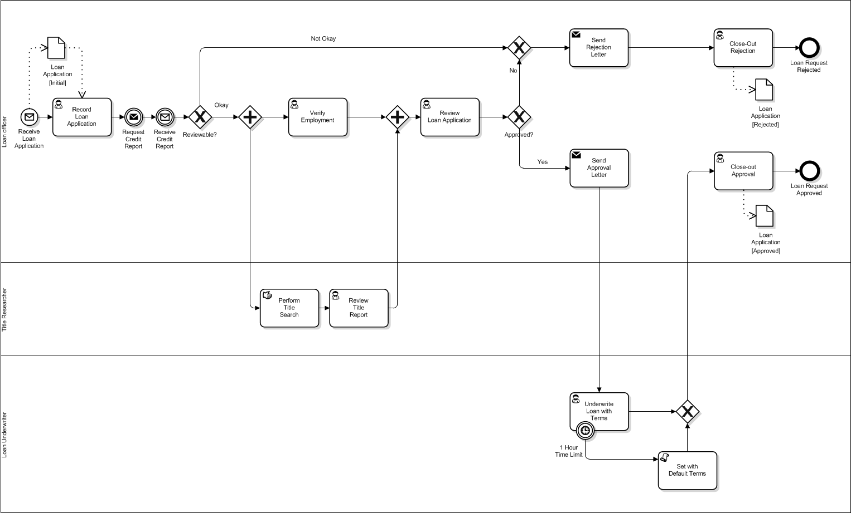
Simulation Use Case – Model With Triage + Early Data Capture
95
Closed
132
Received
NOTE: Probability parameters changed: 4 out of 30 can be rejected on credit score alone, 18 out of remaining 26 will be rejected while 8 will be approved
30
Closed
Simulation Purpose (2B): Facilitate Reengineering of the Process (Part I)!!!
What are the Counts for each pair of outcomes, and is there backlog or merely WIP in the pipeline?
What is the average and maximum Time-in-System (weighted sum of cycle times) for a Loan Application?
WIP | Time-in-System Avg. | Time-in-System Max.
132 - (95+30) = 7 | 141.63 mins. | 229.08 mins.
Main Goals Realized But Stretch Goal Still Not Achieved

Slide 31
Process Redesign – Using Reengineering Patterns (Part II)
Automation
Anti-Pattern: Performance Problem of Activity Is Inefficient
Typically is a manual or user-mediated activity that is seen as taking too much time (especially with respect to peer or contiguous activities), or is generally routine or repetitive in a manner that is better realized through automation
Redesign Pattern: Performance Solution of Automating the Activity
Offending activity is changed to be supported with automation (e.g., manual task changed to user task with user screen(s)) or abstracted out by way of service invocation (e.g., manual or user task changed to a service task provisioned through a system or service provider)
Potential Indicator Measures To Examine:
Cycle Time or Duration Time
Time-in-System
Backlog/WIP
Try automating the Perform Title Search activity by making it a user-mediated online search (with user screens), thus reducing its cycle time and bringing it into alignment with the parallel activities.

Slide 32

Simulation Use Case – Model With (Automation)
93
Closed
132
Received
34
Closed
Simulation Purpose (2B): Facilitate Reengineering of the Process (Part II)!!!
What are the Counts for each pair of outcomes, and is there backlog or merely WIP in the pipeline?
What is the average and maximum Time-in-System (weighted sum of cycle times) for a Loan Application?
WIP | Time-in-System Avg | Time-in-System Max
132 - (93+34) = 5 | 97.82 mins | 179.24 mins
Stretch Goal Realized and Other Goals Realized or Exceeded

Slide 33
Summary
To Summarize...
Purposes of process simulation relate to specific reasons for simulating business processes as part of process analysis
Key concepts of simulation with BPMN models, focusing on the temporal perspective, work queues, and processing times
Process model element simulation parameters (structural parameters) and process performer simulation parameters (non-structural parameters) are connected to the behaviors in the model
Simulation of a process model can be used to diagnose performance problems and to remediate the process via a revised design
As-is anti-patterns exist and can be addressed with redesign patterns as processes are reengineered to address performance problems unearthed through simulation as part of process analysis
Notes:
These points echo back to the Learning Objectives.

Slide 34
Questions & Answers
?

Slide 35


Simulation Tools Showcased in this Webinar
BPMN Web Modeler (with L-SIM)
Trisotech – http://www.trisotech.com/en/index.php
Business Process Incubator – http://www.businessprocessincubator.com/
Lanner –
http://www.lanner.com/
Business Process Incubator
Both are Members of BPSim.org!!!

Slide 36






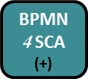

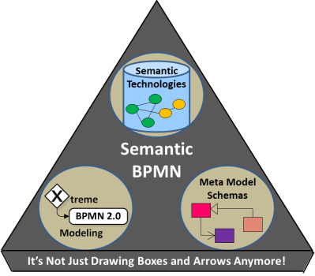


Presenter Bio: Lloyd Dugan
Chief Architect for Business Process Management, Inc. (BPMI, www.bpm.com); e-mail: lloyd@bpm.com
Senior BPMN SME/Trainer for the DoD’s Deputy Chief Management Office (DCMO); e-mail: ldugan@bizmanagers.com
Independent Contractor/Sole Proprietor of LAB Derivations (BPMN4SCA); e-mail: ldugan.bpmn4sca@gmail.com
Co-Founder of Semantic BPMN, combining and leveraging BPMN and Semantic Technologies; e-mail: ldugan.bpmn4sca@gmail.com
Senior BPMN SME/Chief Architect for the Process Modeling Design Center (PMDC) of the VA’s Office of IT (OIT)
Member of the Workflow Management Coalition (WfMC, www.wfmc.org); co-author BPMN 2.0 Handbook
Member of the WfMC’s Business Process Simulation Working Group (BPSim, www.bpsim.org)
Member of the Object Management Group (OMG) BPMN Model Interchange Working Group (MIWG)
OMG-Certified Expert in Business Process Management (BPM) (OCEB) - Fundamental
You Can Find Me On

